Slide 1
PANIMALAR ENGINEERING COLLEGE
BE COMPUTER SCIENCE ENGINEERING
21CS1512 - SociAlly relevant mini project
DOMAIN: DEEP LEARNING
DETECTION OF HIV USING DEEP LEARNING
PRESENTED BY:
RAKSHAKA SELVAN (211422104378) CSE-C
PRIYANKA.G (211422104362) CSE-C
MENTOR NAME:

Slide 2

ABSTract
Human Immunodeficiency Virus (HIV) is a significant global health concern that attacks the immune system, leading to Acquired Immunodeficiency Syndrome (AIDS) if untreated. Early detection of HIV is crucial for effective treatment and prevention of disease progression. This project presents a deep learning-based system for predicting HIV status, utilizing a feedforward neural network architecture. The system processes patient data by extracting key medical and demographic features, allowing it to classify individuals as HIV-positive or negative. Through rigorous data preprocessing, including feature encoding, missing value handling, and feature scaling, the model is trained using a substantial dataset with labeled outcomes. It employs binary crossentropy as the loss function and the Adam optimizer for effective training. Key performance metrics, such as accuracy, confusion matrix, and ROC curve analysis, validate the model's reliability and predictive capabilities. The proposed system aims to facilitate early detection of HIV, providing healthcare practitioners with rapid and accurate predictions to aid in patient care and treatment planning.

Slide 3
EXISTING system
Here are the top 6 HIV prediction and detection systems with brief descriptions:
1. DeepGen-HIV - Predicts drug resistance from HIV genotype sequences using machine learning.
2. DeepHIV - Utilizes CNNs to analyze next-generation sequencing (NGS) data for HIV detection.
3. HIV-TRACE - Identifies HIV transmission clusters by analyzing genetic sequence data.
4. geno2pheno - Predicts HIV drug resistance based on genetic sequences using machine learning.
5. HIV-PR- Deep learning model predicting HIV protease inhibitor resistance.
6. CleavPredict - Machine learning model predicting HIV protease cleavage sites to guide treatment.

Slide 4
Proposed system
Overview: A deep learning model for binary classification of HIV status based on processed patient data.
Input Data: Includes medical and demographic features like age, marital status, STD history, and education.
Architecture:
Feedforward Neural Network: Comprises input, hidden, and output layers.
Hidden Layers: Extract and transform features.
Output Layer: Provides the probability of HIV positivity.
Data Preprocessing:
Feature Encoding: Converts categorical features to numerical form.
Missing Value Handling: Addresses missing data through imputation.
Feature Scaling: Standardizes numerical data for balanced contributions.
Prediction: Outputs real-time classifications of HIV status based on a probability threshold.
Deployment: Designed as a web or mobile application for healthcare practitioners to assist in early detection and treatment planning.
Goal: Provides accurate risk assessments to aid in the early detection and prevention of HIV.

Slide 5
Hardware components
Computing Device: Intel i7/i9, AMD Ryzen 7/9 or better, 16 GB RAM or higher, 512 GB SSD or higher.
Peripherals: Monitor, keyboard, mouse.
Networking: Stable internet connection.
Power: Uninterrupted power supply (UPS).
Cloud Resources: Cloud storage and compute instances for model hosting and deployment.

Slide 6
Software components
Python 3.x: For scripting and building the application.
TensorFlow/Keras: For building and training the deep learning model.
Scikit-learn: For data preprocessing and scaling.
Pandas: For data manipulation and processing.
Streamlit: To create the web app interface.
Joblib: For saving and loading the scaler.
Google Colab: For training and testing the model.
Jupyter Notebook: For development and experimentation.

Slide 7
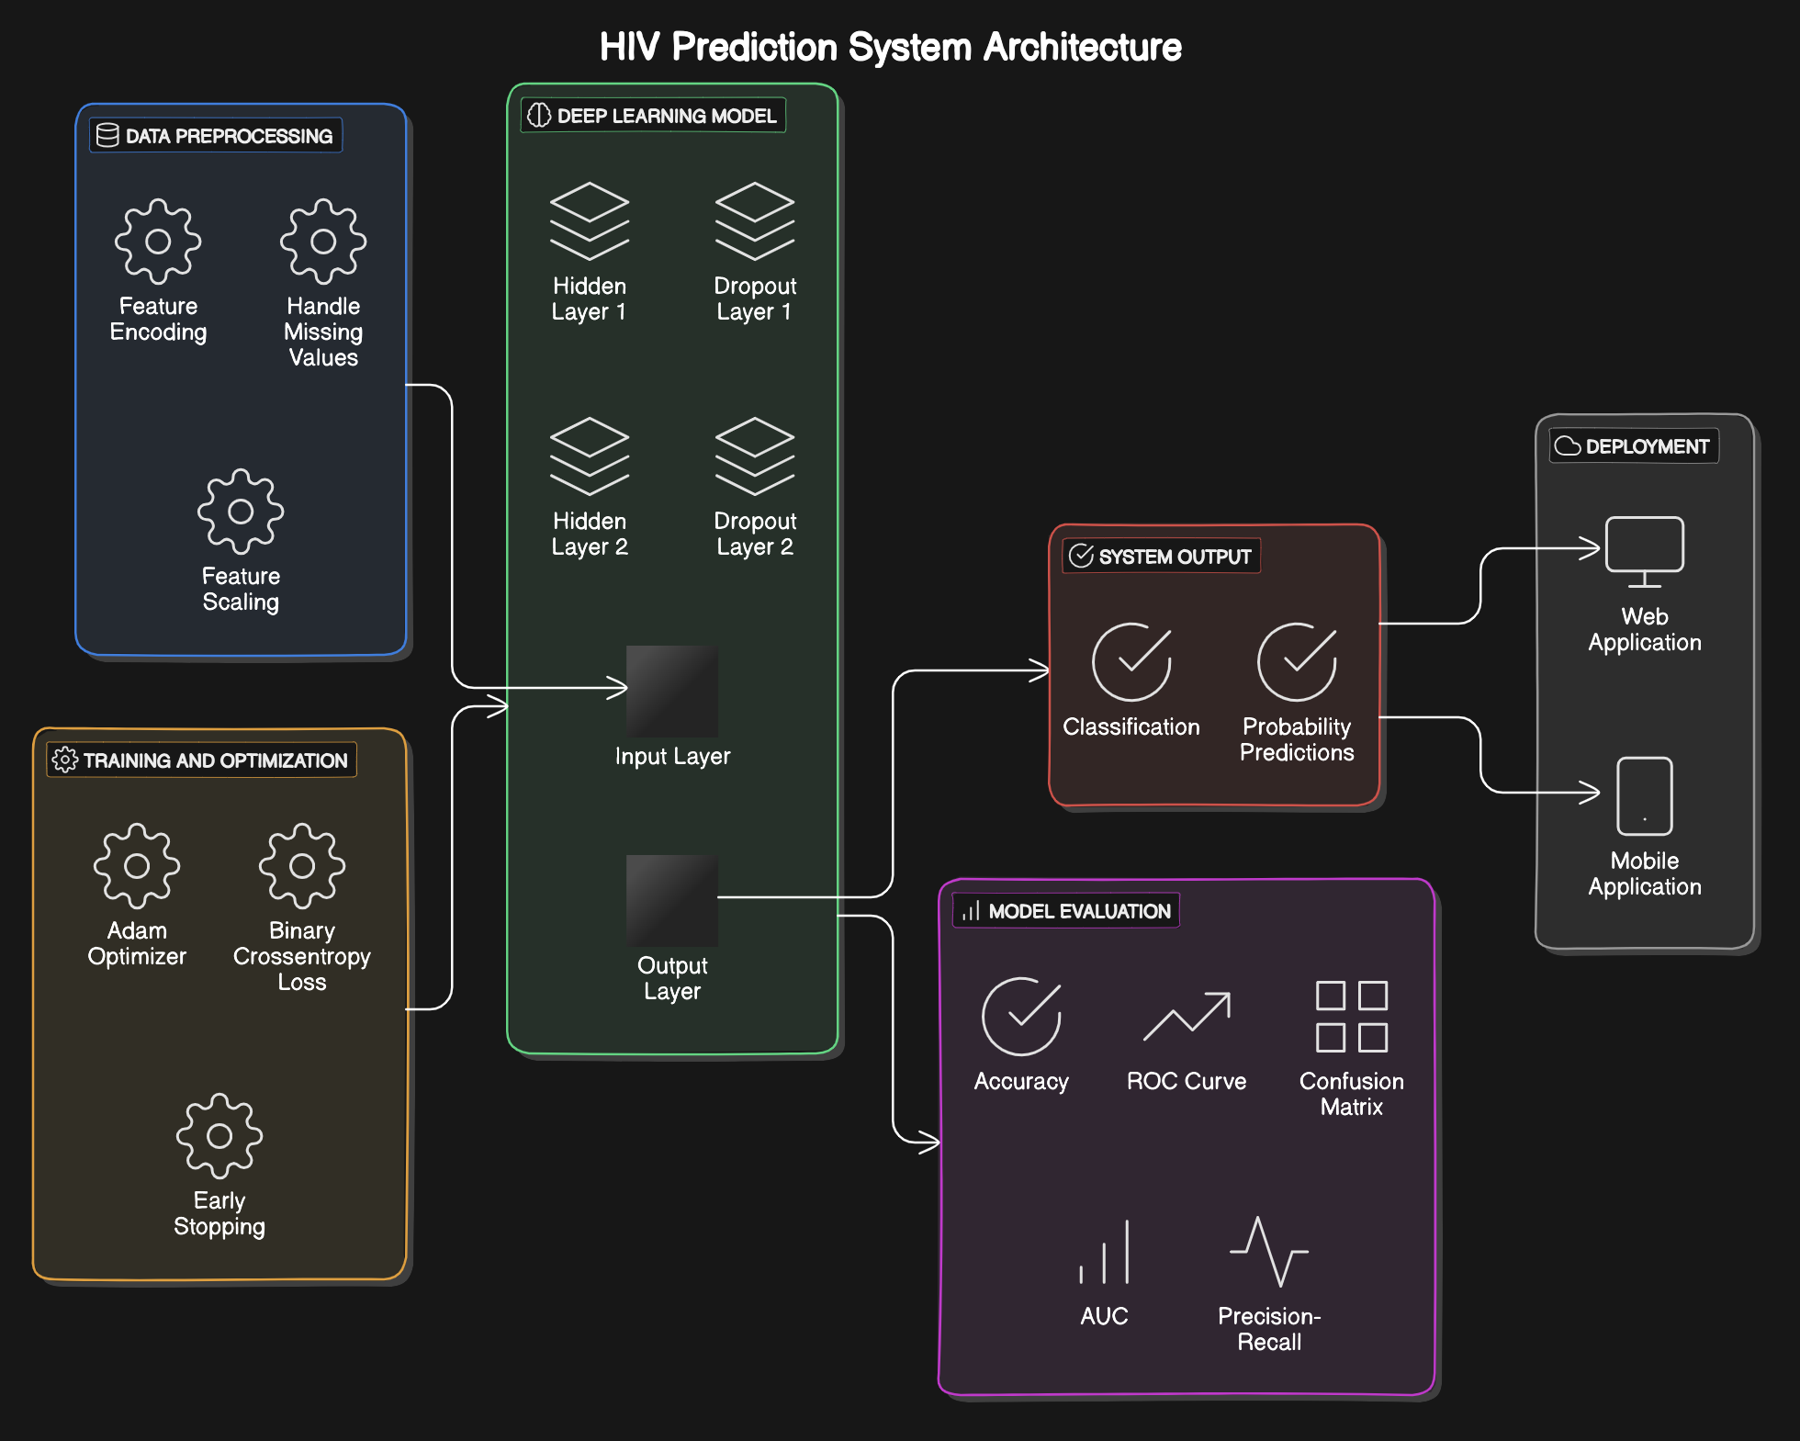
ARCHITECTURE

Slide 8
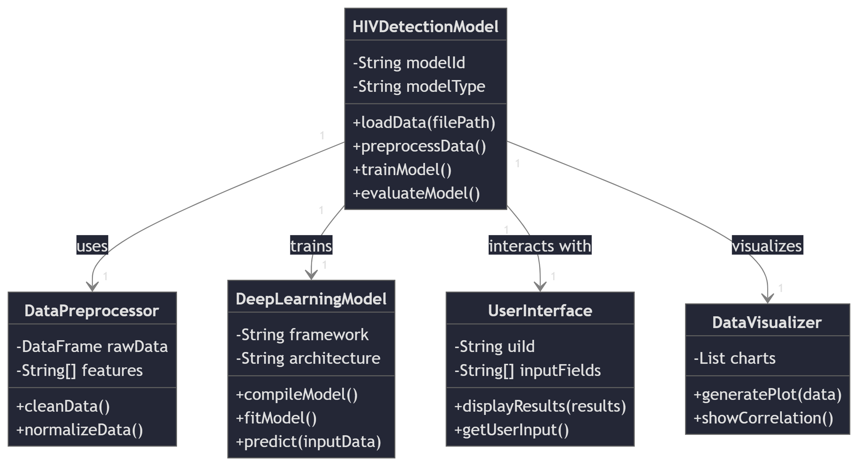
UML CLASS DIAGRAM

Slide 9
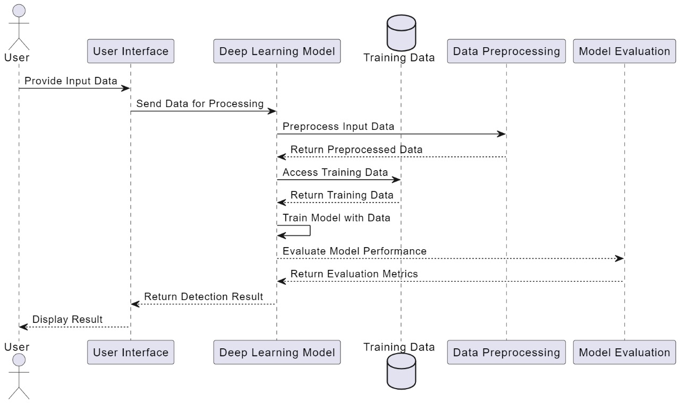
SEQUENCE DIAGRAM

Slide 10
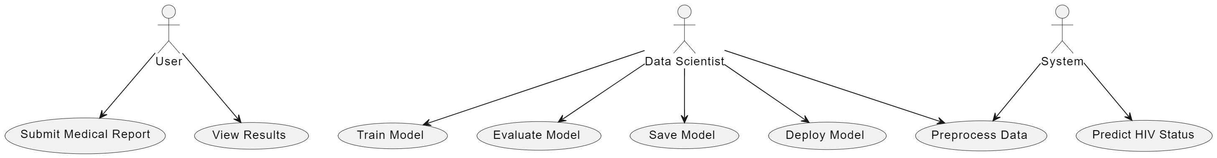
USE CASE DIAGRAM

Slide 11
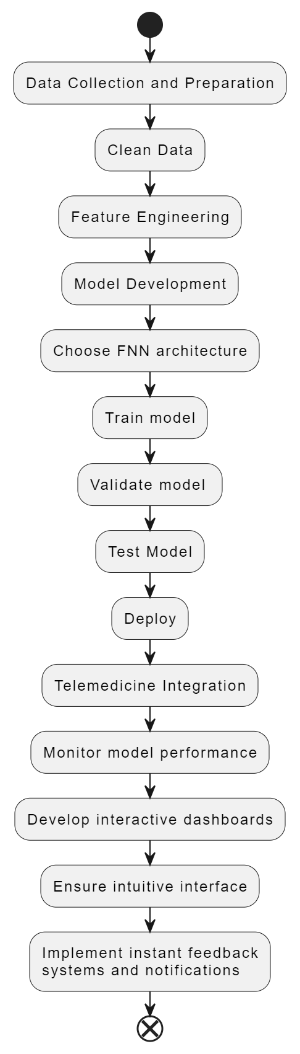
ACTIVITY DIAGRAM

Slide 12
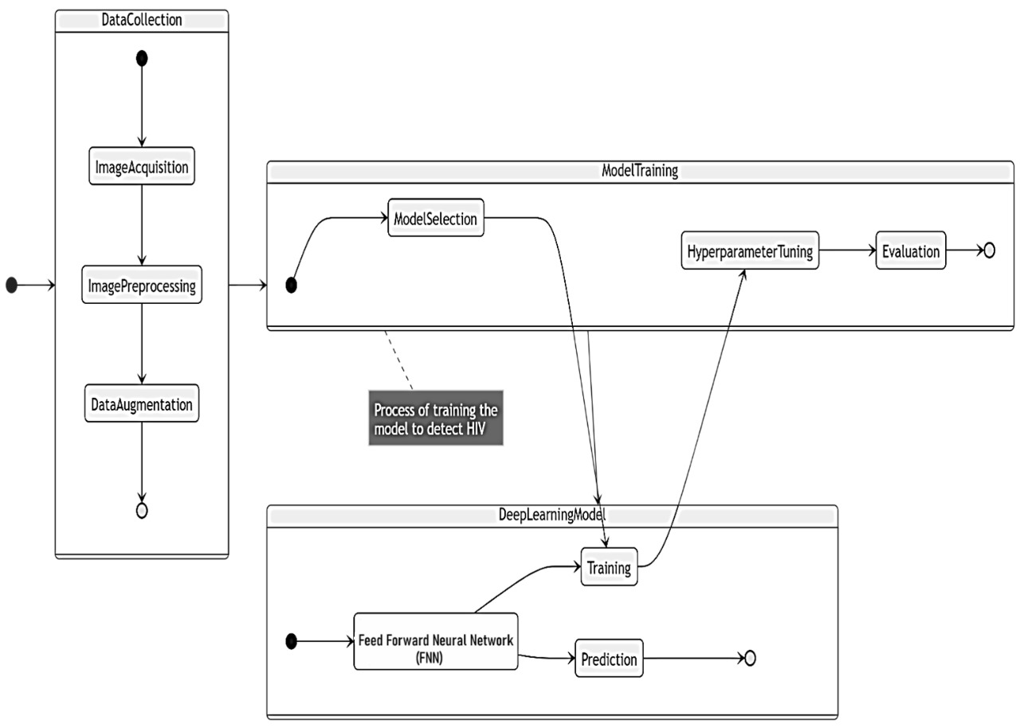
STATE CHART DIAGRAM

Slide 13
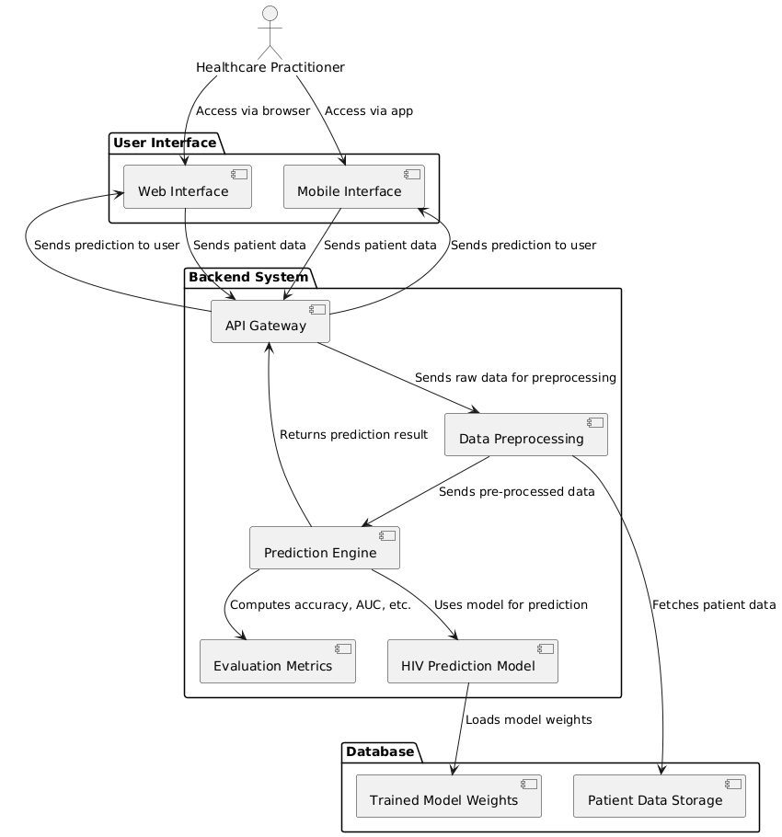
COMPONENT DIAGRAM

Slide 14
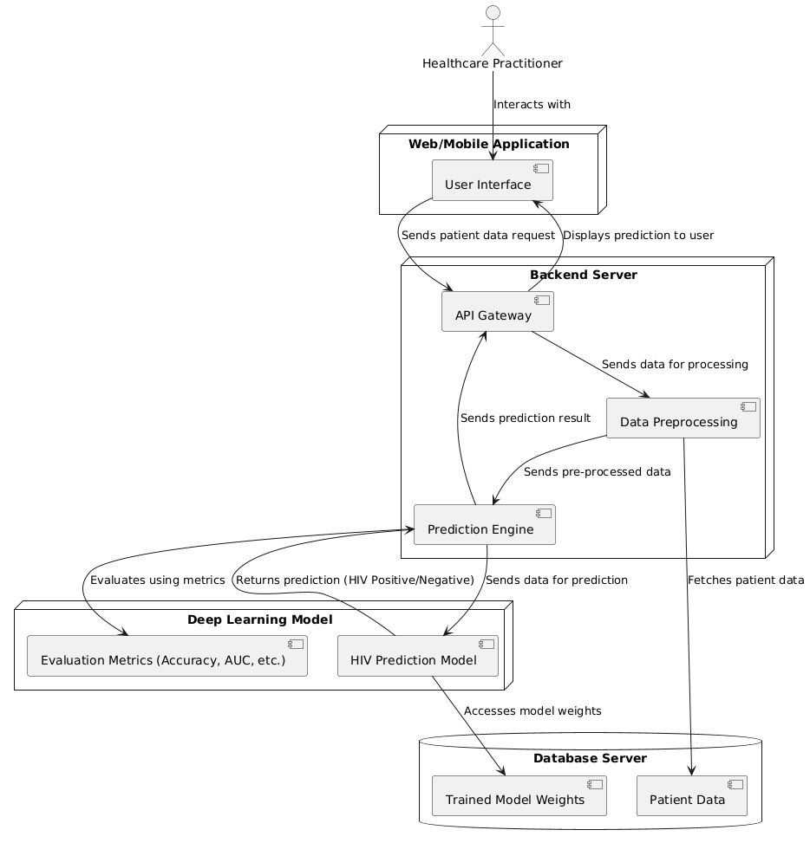
DEPLOYMENT DIAGRAM

Slide 15
MODULES
1. Data Collection and Preprocessing:
This module integrates clinical data and EHRs to gather comprehensive patient information, including HIV test results. Data is cleaned, normalized, and prepared for the model through handling missing values, noise reduction, and feature extraction.
2. Deep Learning Model:
The Feed Forward Neural Network (FNN) is designed to learn patterns from preprocessed data indicative of HIV infection. It uses advanced techniques to achieve high accuracy in detection.
3. Prediction and Instant Feedback:
This module generates real-time predictions on new patient data, assessing HIV presence and potential risk factors. Instant feedback ensures timely decision-making for healthcare providers and patients.
4. User Interface:
Interactive dashboards built with tools like Streamlit enable easy access to data and predictions. The user-friendly design ensures efficient interaction for healthcare professionals.
5. Cloud Deployment:
The system is deployed on scalable cloud infrastructure, ensuring accessibility and performance for large datasets and multiple users. Cloud deployment provides the necessary computational power for smooth operation.
6. Performance Monitoring:
This module tracks system performance and implements periodic updates and retraining to improve accuracy. Continuous monitoring ensures the system stays up-to-date and reliable in detecting HIV.

